Slide 1
VibeAlert
Davia Mckenzie, Auric Saha, and John Watkins

Slide 2
Description of VibeAlert
Our echo location devices uses the HC-SR04 Sonar Sensor to detect the distance of unanimous object in front of the user. When the user enters a specific range away from any object in front of them, the echo location device will sound an alarm sound and vibration for the hearing impaired. If the user enters a closer range to the object in front of them the vibration will become continuous, and the alarm sound will become more intense.

Slide 3
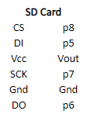


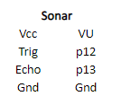

Block Diagram of Circuit Board
Mbed
Gnd
Vin
P5
p6
p7
P8
p12
P13
p18
Vout
VU
p22

Slide 4
Software used and developed (Gantt Chart)

Slide 5
Picture of project (diagram)

Slide 6
Summary of results / possible additions

